Slide 1


Slide 2

About the Company
It is an online game where users create a virtual team of real-life players and
earn points based on the performances of these players in real matches
A user who scores the maximum points in their joined contests attains the first rank
on the leaderboard. Dream11 offers free and paid contests.

Slide 3
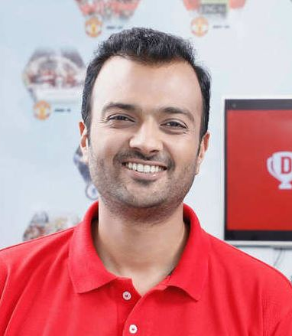
About the Founders
Harsh Jain and Bhavit Sheth started DREAM11
Harsh is the CEO with a
background in business

Slide 4


Bhavit is the COO with expertise in engineering and management.

Slide 5

Current Situation
As of 2021, DREAM11 is India's biggest fantasy sports platform.
It got investments, partnered with sports leagues, and faced discussions about whether it was a game of skill.
It's working to handle challenges and promote responsible play.

Slide 6

Future Goals
Looking ahead, DREAM11 aims to grow its users, improve its platform, and expand to new markets.
They might also add more sports and tech to keep users engaged.

Slide 7
Name-Mansi Gaud
Roll No-73
Mcom-II (BM)

